Slide 1
PHP application Deployment with jenkins

Slide 2
Index
Infrastructure
Requirements
Architecture
Implement CI for Php application
Continuous Deploy with Jenkins

Slide 3
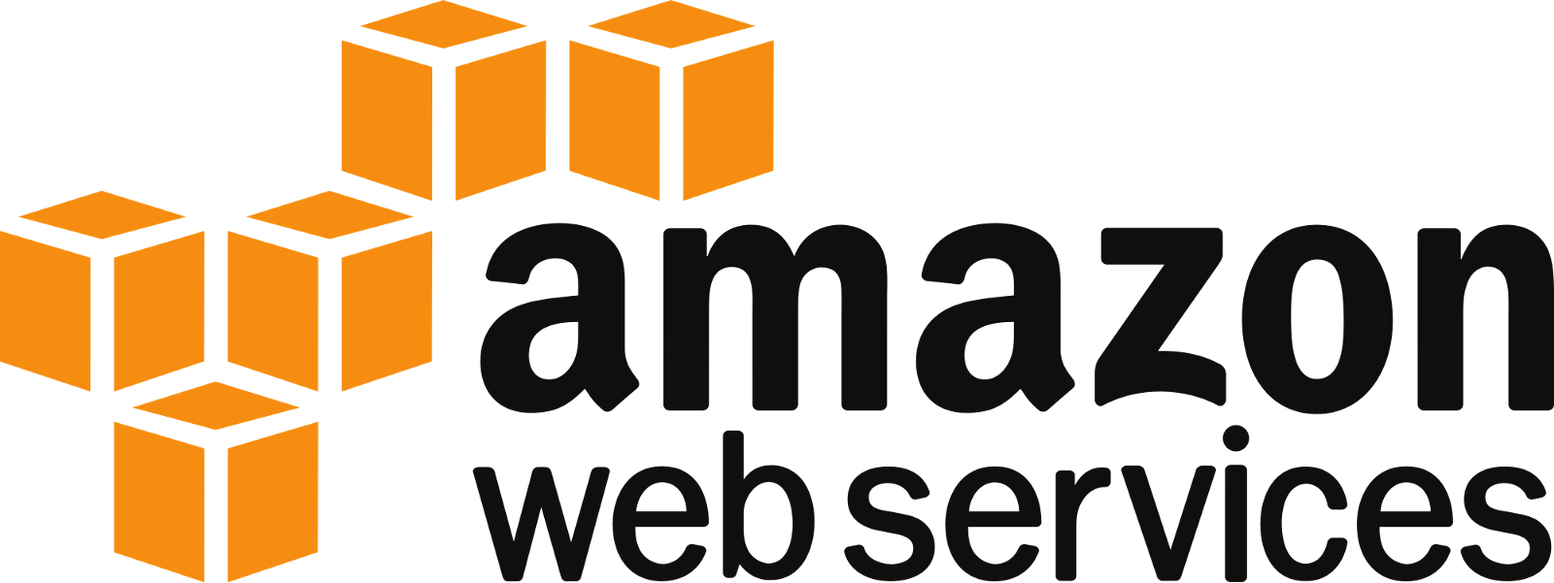

Infrastructure:

Slide 4
Requirements :
TortoiseSVN(local repo): doesn't require the Subversion command line client to run. And it is free to use, even in a commercial environment. Simply the coolest Interface to (Sub)Version Control!
Aws ec2-redhat:svn central server
Gcp centos7:jenkinsmaster
Amzon Ec2-redhat:jenkins node 1 for build job
Amazon S3:store the Arifacts
Amazon RDS:Database mysql
Amazon Ubuntu:node 2 for deploy the application

Slide 5
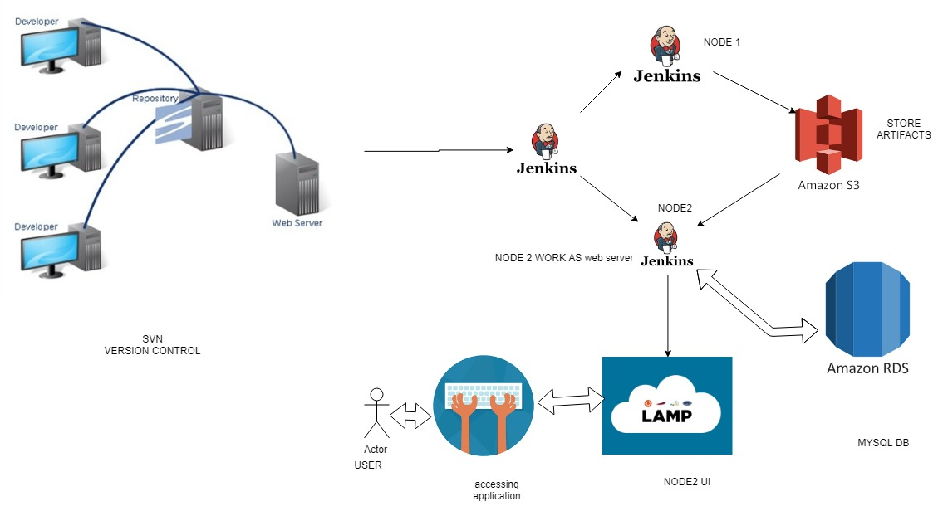
Architecture

Slide 6
Implement CI for Php app by using Jenkins
Jenkins :it’s open source CI tool ,it written in simple java code
Jenkins is used by teams of all sizes, for projects in a wide variety
of languages and technologies, including .NET, Ruby, Groovy, PHP and more, as well as Java.
Continuous integration : CI automate the build and test process Whenever the changes made in source code and send the immediate feedback to the concern team

Slide 7
Continuous Deploy with Jenkins
Created new job for deployment purpose
Installed the lamp stack and httpd on the Machine
Pull Artifacts from the S3 to deployment Machine
Access the Application from this machines

